Slide 1
Kansas Counties Dataset Presentation
Ishpreet Saini

Slide 2
Introduction
In this presentation, we will work with the dataset “KansasCounties” provided in Module 12 material and build different visualizations in R using Shiny app. Shiny allows data scientists and analysts to turn their R-based analyses and visualizations into interactive web applications without needing to write HTML, CSS, or JavaScript code.

Slide 3
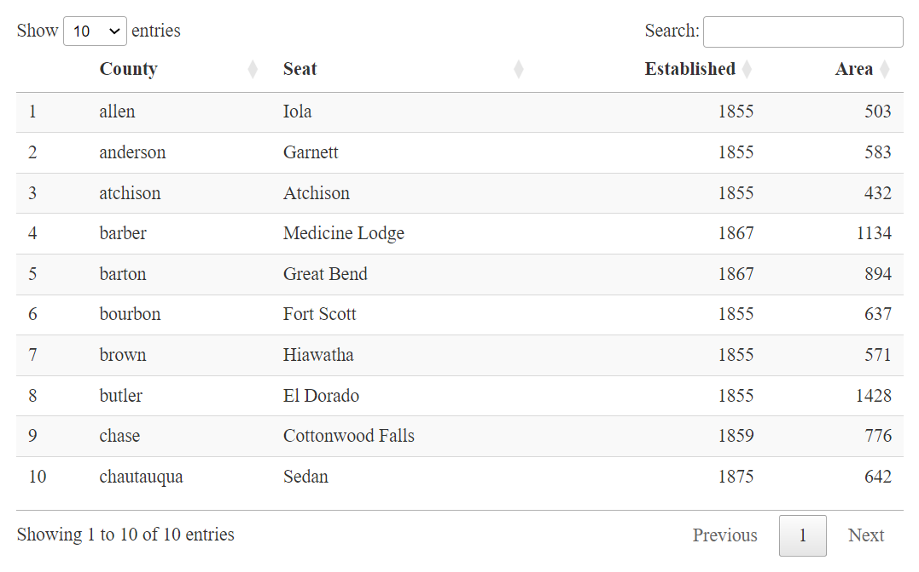
Data Overview
Key Variables:
County: The name of the Kansas county.
County Seat: The administrative center of the county.
Established: The year when the county was established.
Area: The area of the county in square miles.
Data includes both temporal (establishment year) and spatial (county area) data, allowing for diverse analyses.
Kansas Counties Dataset

Slide 4
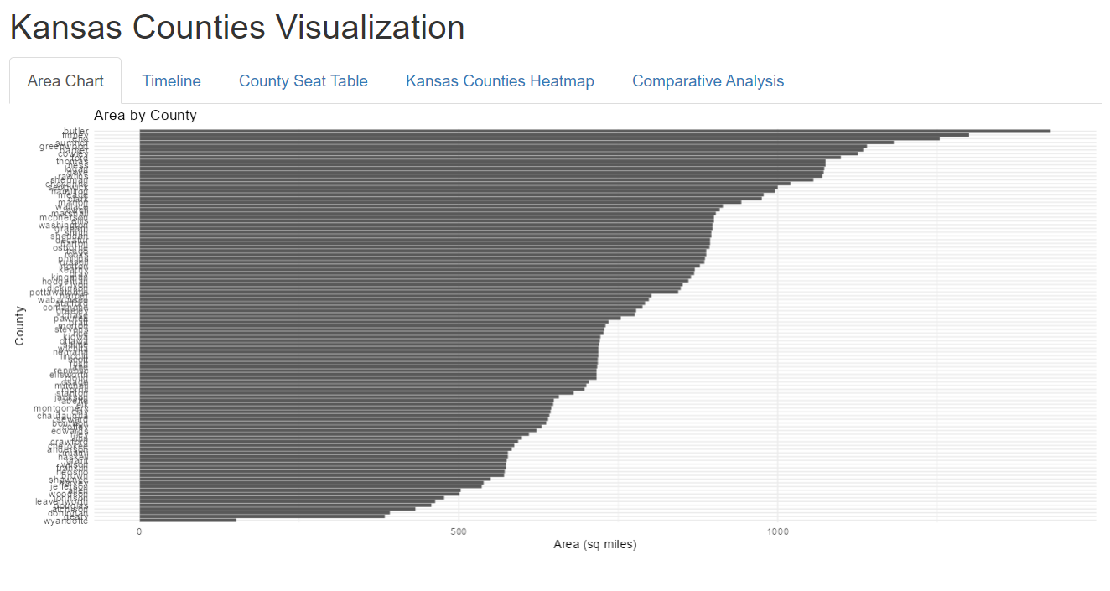
Visualization 1 - Area Chart
Looking at the visual it can be inferred that the butler county has the largest area versus the Wyandotte county having the smallest area among the all counties in Kansas.

Slide 5
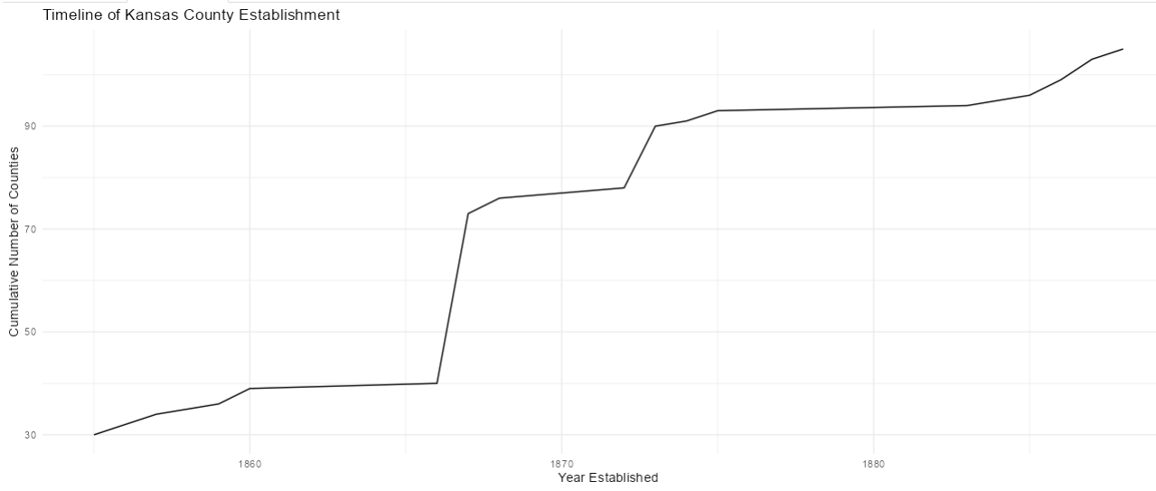
Timeline of County Establishment
Visualization 2 - Timeline
The timeline shows the establishment years of counties and how the number of counties has increased over time. The visual shows the historic trend of most number of counties established in the years 1865 through 1870.

Slide 6
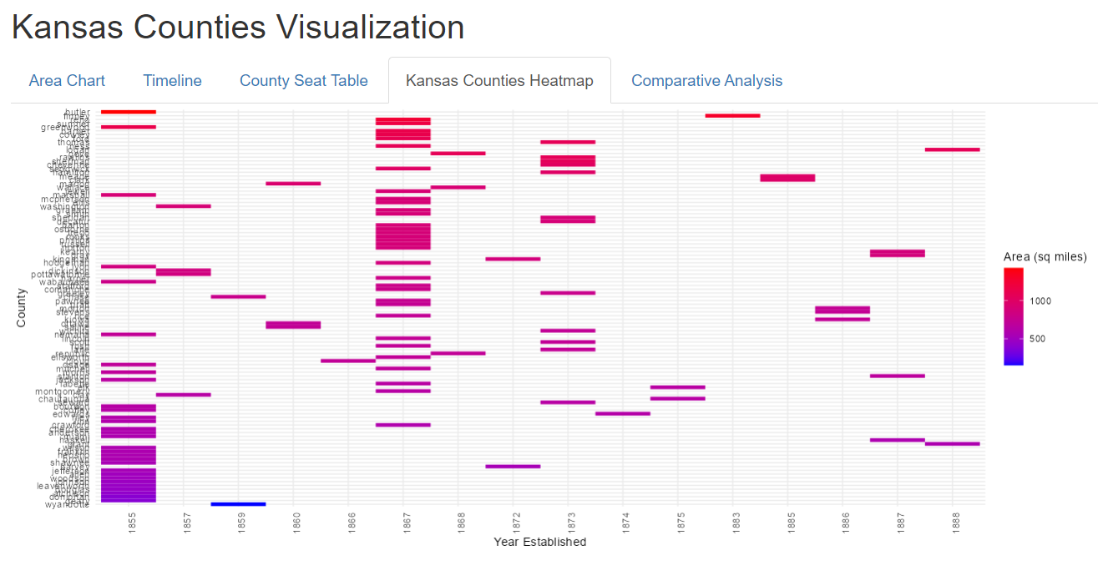
Kansas Counties Heatmap
The heatmap visualizes the relationship between establishment year and county area. Looking at the heatmap, the smallest area counties are established in the early years.
Visualization 3 - Heatmap

Slide 7
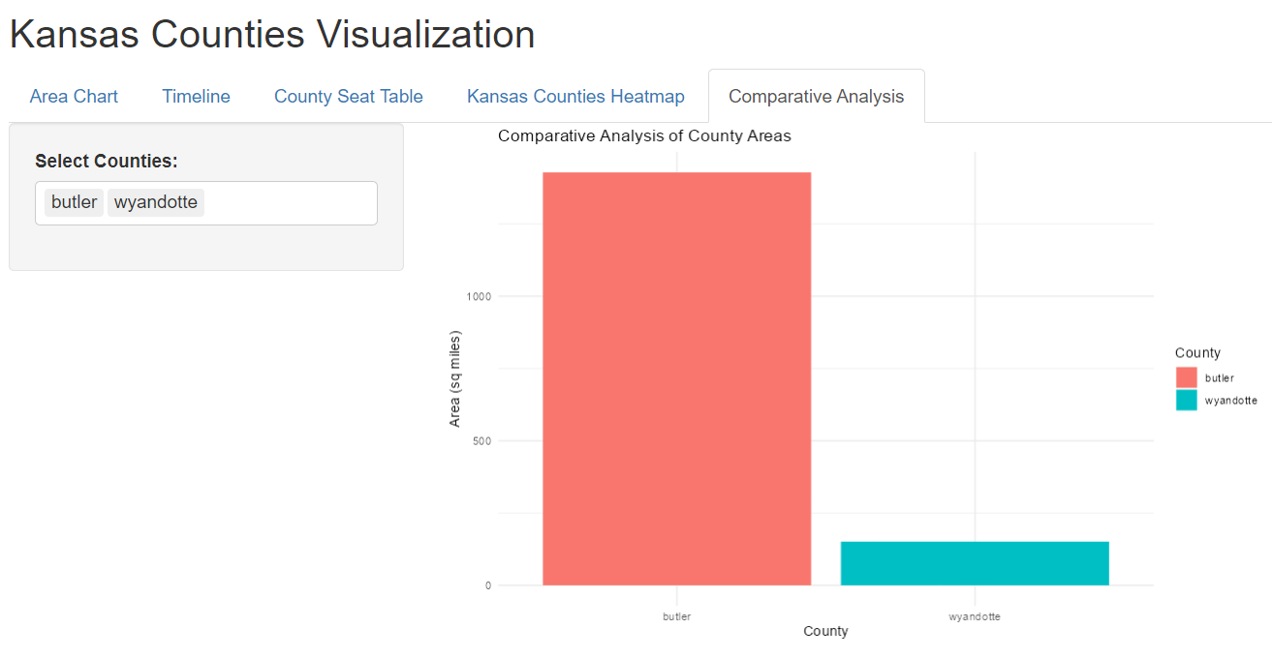
Comparative Analysis
The visual here gives a interactive plot based on the selection of the county. The plot is Area vs county plot comparing the sizes of the county. In the provided visual, I have selected the county Butler and Wyandotte which represent the largest and smallest county in Kansas.
Visualization 4 - Comparative Analysis

Slide 8
SUMMARY
My Shiny app includes various features to analyze and visualize data about Kansas counties, such as interactive plots, area charts, timelines, and comparative analysis. The app aims to provide insightful visualizations and comparative analytics on county data, including attributes like the area, seat, year of establishment, etc.

Slide 9
THANK YOU
Ishpreet Saini
Git Hub link: https://github.com/isaini13/Data824FinalProject.git

